Slide 1
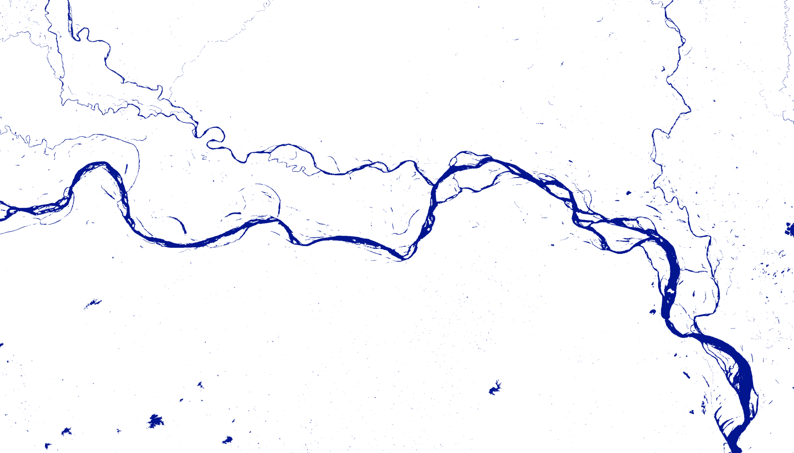



Philip Kraaijenbrink & Marjolein Vogels
Department of Physical Geography Google Earth Engine Workshop 25 September 2018

Slide 2
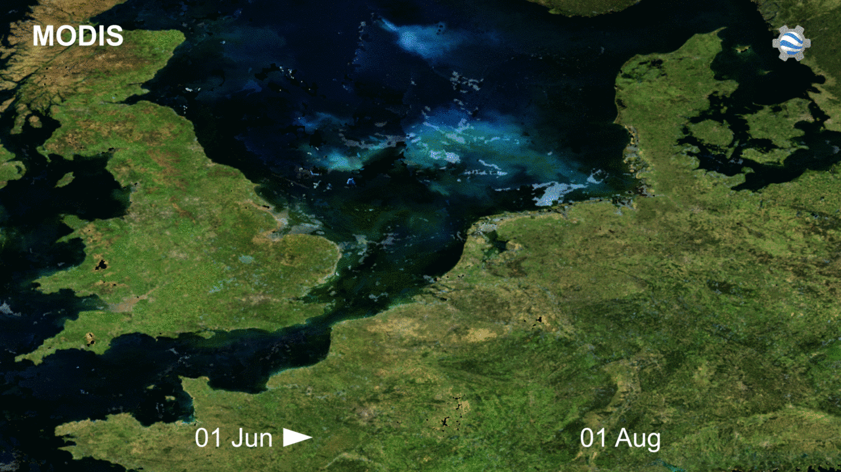

Slide 3
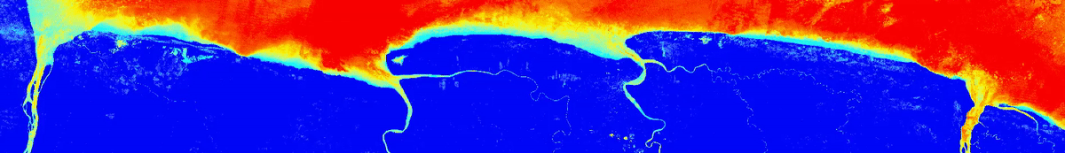

Slide 4
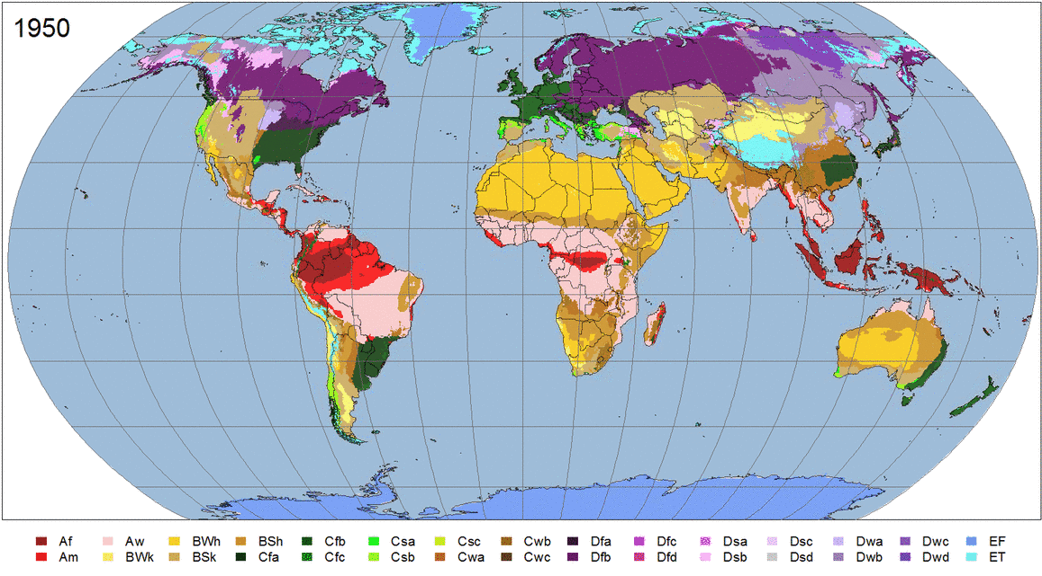

Slide 5
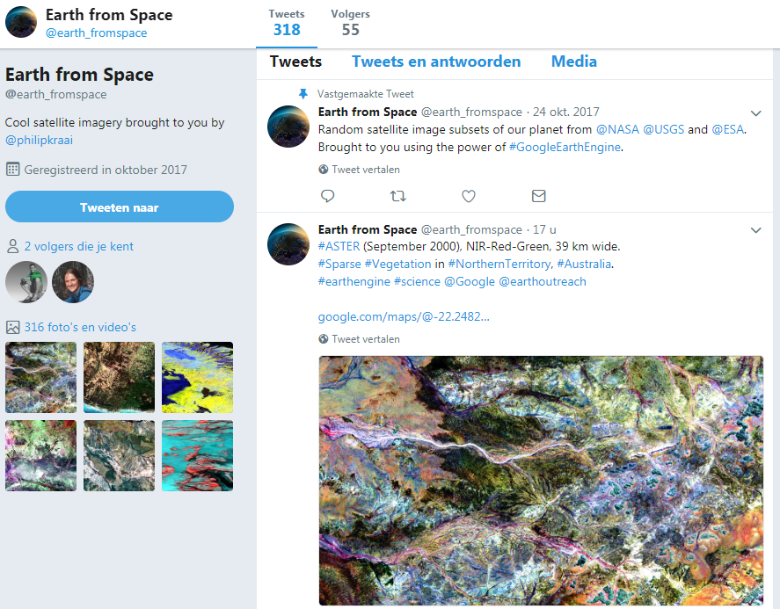
https://twitter.com/earth_fromspace

Slide 6


Google Earth
Earth Engine
3-D Globe Visualization
Geospatial Analysis
Notes:
Google Earth and Earth Engine are two separate technologies, focused on solving separate problems.
Google Earth is a rich 3-D basemap on which raster and vector data can be overlaid.
Earth Engine enables the processing of massive amounts of raster and vector data, that may results in a variety of outputs such as tiles for 2-D interactive maps, tables, video, or images that can be displayed on Google Earth.

Slide 7
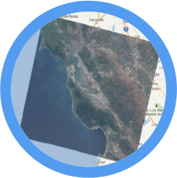
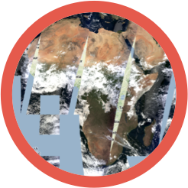
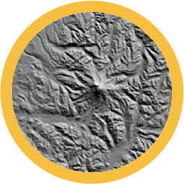
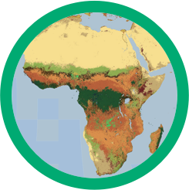
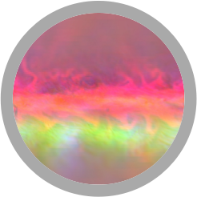

Cloud based geospatial analysis
Requests
Results
Geospatial Datasets
add
mosaic
distance
filter
Algorithms
join
focal_min
convolve
reduce
Storage and Compute
Notes:
"Cloud computing: it's as if you had access to a supercomputer designed for geospatial analysis"

Slide 8
Large Public Data Catalog
Landsat 4, 5, 7, 8
Raw, TOA, SR, ...
MODIS
Daily, NBAR, LST, ...
Terrain
SRTM, GTOPO, NED, ...
Land Cover
GlobCover, NLCD, ...
Atmospheric
NOAA NCEP, OMI, ...
... and many more, updating daily!
> 200 public datasets
> 4000 new images every day
> 5 million images
> 5 petabytes of data

Slide 9
Google Earth Engine Aims
Highly-interactive algorithm development at global scale
Push the edge of the envelope for big data in remote sensing
Enable high-impact, data-driven science
Make substantive progress on global challenges that involve large geospatial datasets

Slide 10
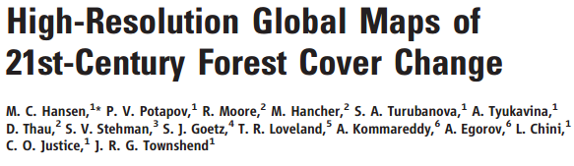
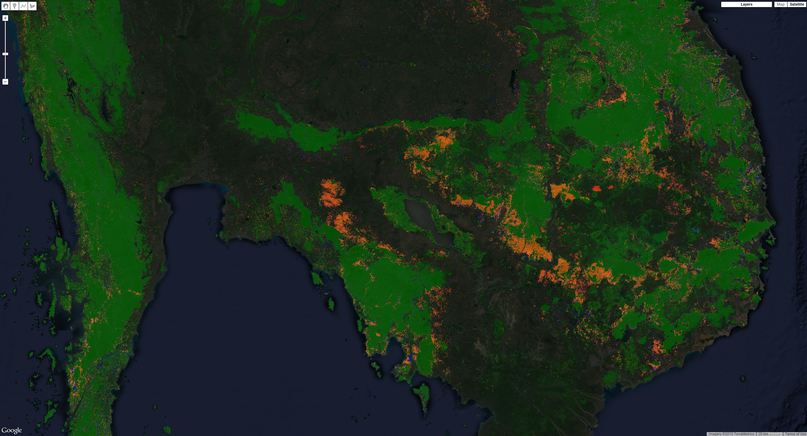
https://earthenginepartners.appspot.com/science-2013-global-forest
Notes:
The first big study that made use of Earth Engine was Hansen et al. (2013) in which the authors quantified forest cover in year 2000 and decadal deforestation between 2000 and 2012, at 30 meters resolution, global scope, using Landsat data. The map above shows the Mekong basin, with forest cover in green, deforestation in red and reforestation in blue. These data are available to every Earth Engine user for use in other analyses.

Slide 11
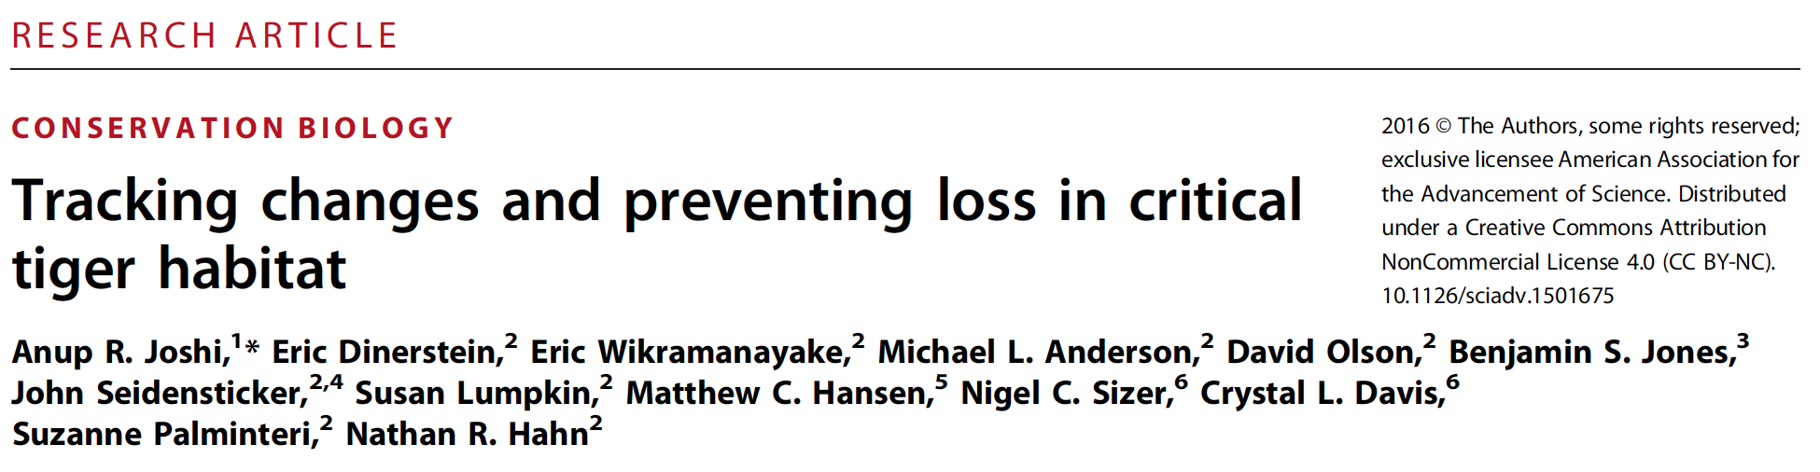

"This study was made possible by free availability of satellite imagery, cloud computing services, and interactive web tools. We were able to analyze 14 years of high-resolution global forest loss data across 76 landscapes that span 13 countries."
Photo: Dibyendu Ash, www.goingwild.com
Notes:
Joshi et al. (2016) used the Hansen et al. dataset to quantify tiger habitat in key protected areas. They used Earth Engine to complete their analysis.

Slide 12
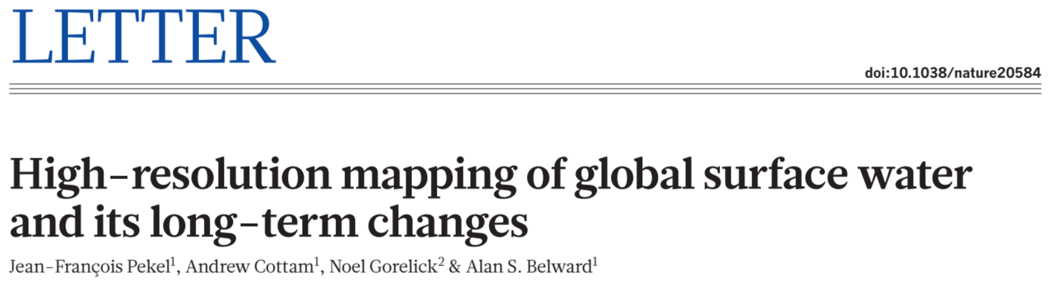
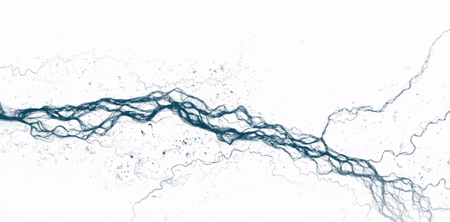
Image credit: New York Times
Notes:
This visualization is from the New York Times article about the Pekel et al. publication:
https://www.nytimes.com/interactive/2016/12/09/science/mapping-three-decades-of-global-water-change.html

Slide 13

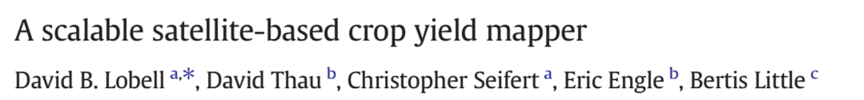
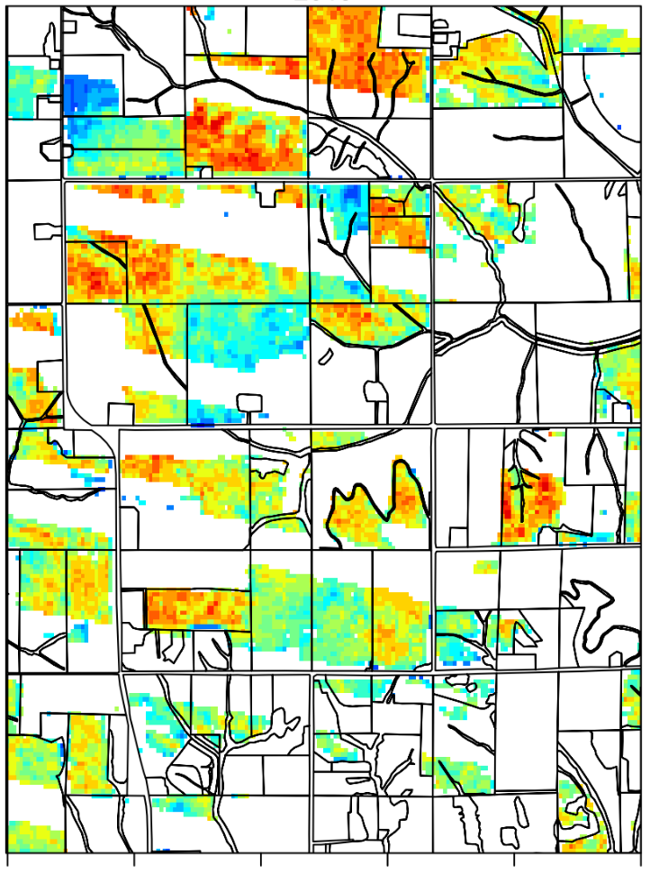
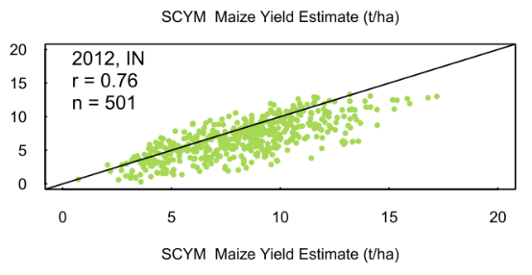
http://www.sciencedirect.com/science/article/pii/S0034425715001637
Notes:
Lobell et al. (2016) fit regressions from many simulations of crop growth over a range of meteorological variables. They used relationships between RS variables and model variables (e.g. VI <-> LAI) to apply the equation in each pixel. They compare aggregate predictions to reported yields (with varying success).

Slide 14
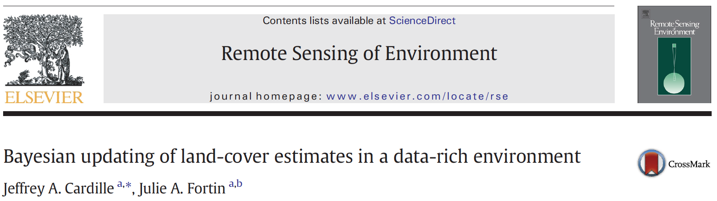
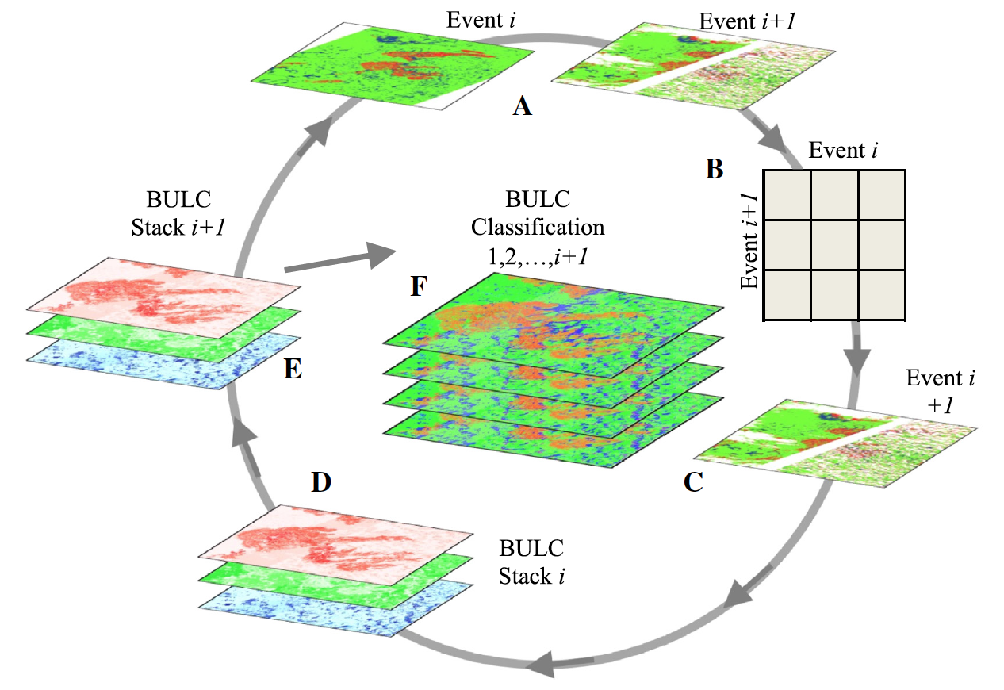
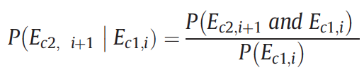
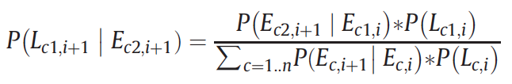
Notes:
Cardille et al. (2016) used time series of Landsat in conjunction with a Bayesian model to improve sequences of land cover classifications. They produced a sequence of better classifications by combining evidence from each semi-good classification.

Slide 15

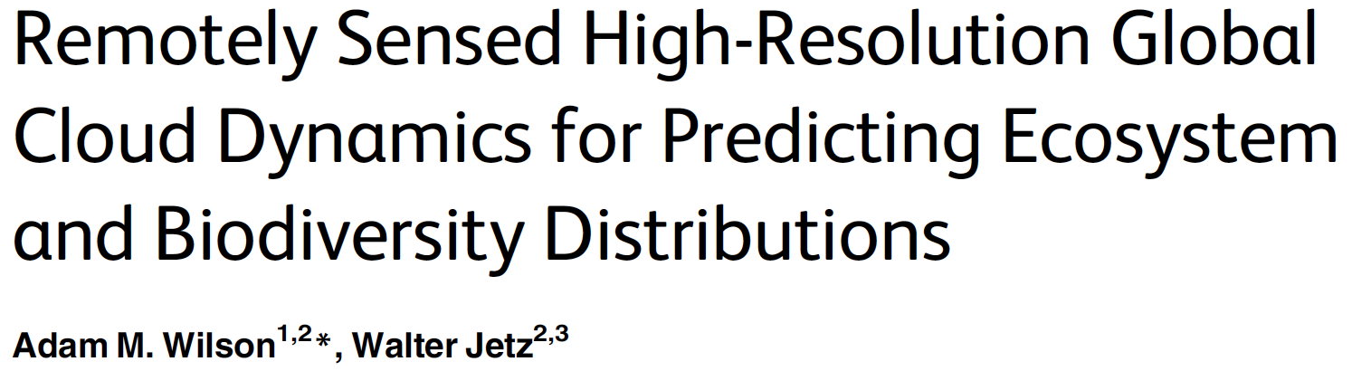
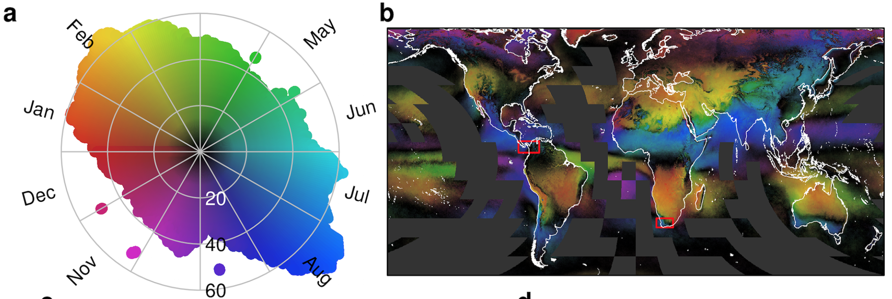
http://journals.plos.org/plosbiology/article?id=10.1371/journal.pbio.1002415
http://www.earthenv.org/cloud
Notes:
This is a paper and an app. Wilson and Jetz (2016) used cloud flags in MODIS time series to estimate spatio-temporal variability of cloudiness and its relationship to ecosystem type.

Slide 16
Data Types and Geospatial Processing Functions
Image - band math, clip, convolution, neighborhood, selection ...
Image Collection - map, aggregate, filter, mosaic, sort ...
Feature - buffer, centroid, intersection, union, transform ...
Feature Collection - aggregate, filter, flatten, merge, sort …
Filter - by bounds, within distance, date, day-of-year, metadata ...
Reducer - mean, linearRegression, percentile, histogram ….
Join - simple, inner, outer, inverted ...
Kernel - square, circle, gaussian, sobel, kirsch …
Machine Learning - CART, random forests, bayes, SVM, kmeans, cobweb …
Projection - transform, translate, scale …
over 1000 data types and operators, and growing!
Notes:
Image is the fundamental raster data structure in Earth Engine. Bands. Pixels. Metadata.
ImaeCollection is stack or time series of images.
Feature is the fundamental vector structure in Earth Engine. Geometry and metadata.
FeatureCollection is a collection of Features (surprise).
Filter is how to limit the scope of analysis temporally, spatially or by metadata.
Reducer is the way to aggregate data. Statistics such as min, max, mean, SD, variance, covariance, linear regression, etc.
Joins are the way to combine different data sets.
Kernel facilitates image processing operations, for example convolution.
Machine Learning algorithms support supervised and unsupervised classification.
Projection is the way to control scale and appearance of data outputs.
And growing in response to user requests.

Slide 17
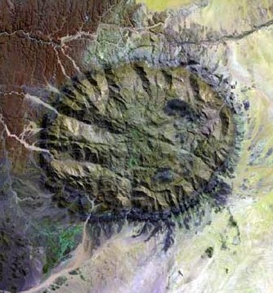
What can you do with Earth Engine?
Get an Image
Pick your: Projection, resolution, bands, bounding-box, visualization
Notes:
Very quick example workflow. Get an image by filtering to the time/area of interest.

Slide 18
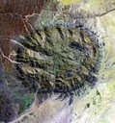
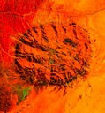
What can you do with Earth Engine?
Get an Image
Apply an algorithm to an image
Library functions or script your own.
Notes:
Apply an algorithm, for example, compute NDVI. This can be either a built in function or a user defined function.

Slide 19
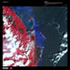
What can you do with Earth Engine?
Get an Image
Apply an algorithm to an image
Filter a collection
Time, Space & Metadata search
Notes:
Get a collection of images and filter to the time and place of interest.

Slide 20
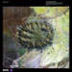

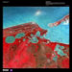
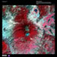
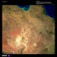
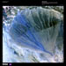
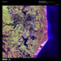
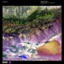
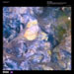
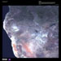
What can you do with Earth Engine?
Get an Image
Apply an algorithm to an image
Filter a collection
Map an algorithm over a collection
N → N
Notes:
Map an algorithm over the collection. For example, compute NDVI for every image in the stack.

Slide 21
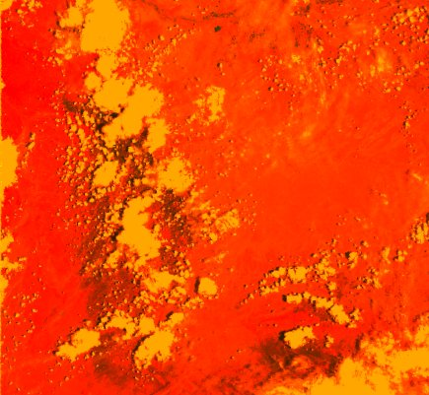
What can you do with Earth Engine?
Get an Image
Apply an algorithm to an image
Filter a collection
Map an algorithm over a collection
Reduce a collection
N → 1 or N → M
Notes:
Reduce the collection to get a composite. (i.e. aggregate over time)

Slide 22
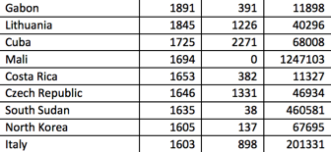
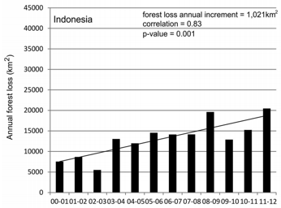
What can you do with Earth Engine?
Get an Image
Apply an algorithm to an image
Filter a collection
Map an algorithm over a collection
Reduce a collection
Compute aggregate statistics
Notes:
Reduce a composite to get statistics. (i.e. aggregate over space)

Slide 23
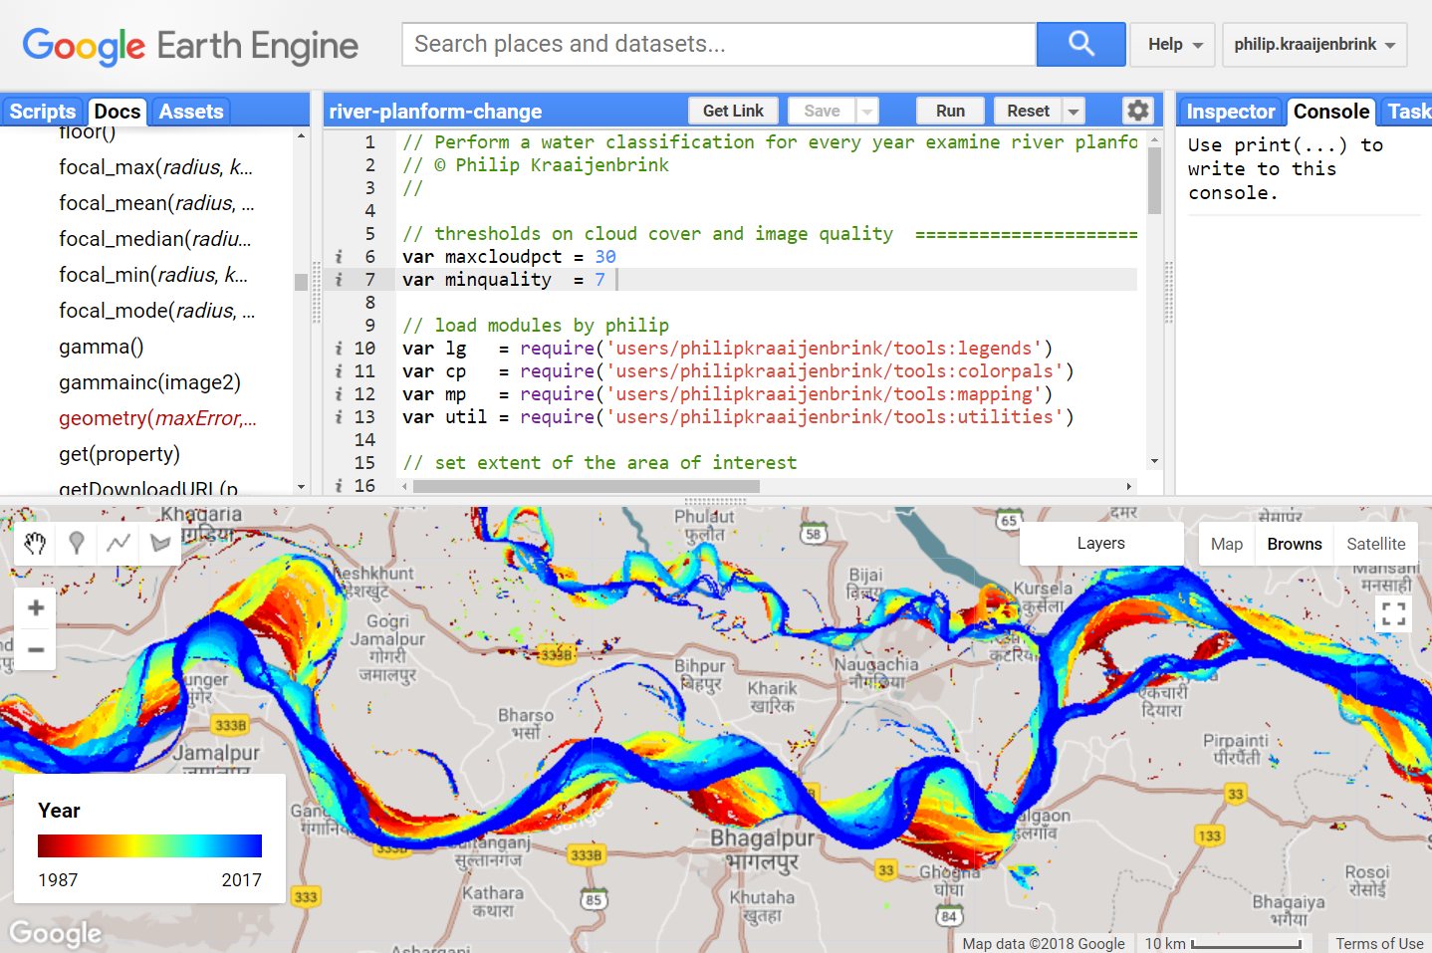
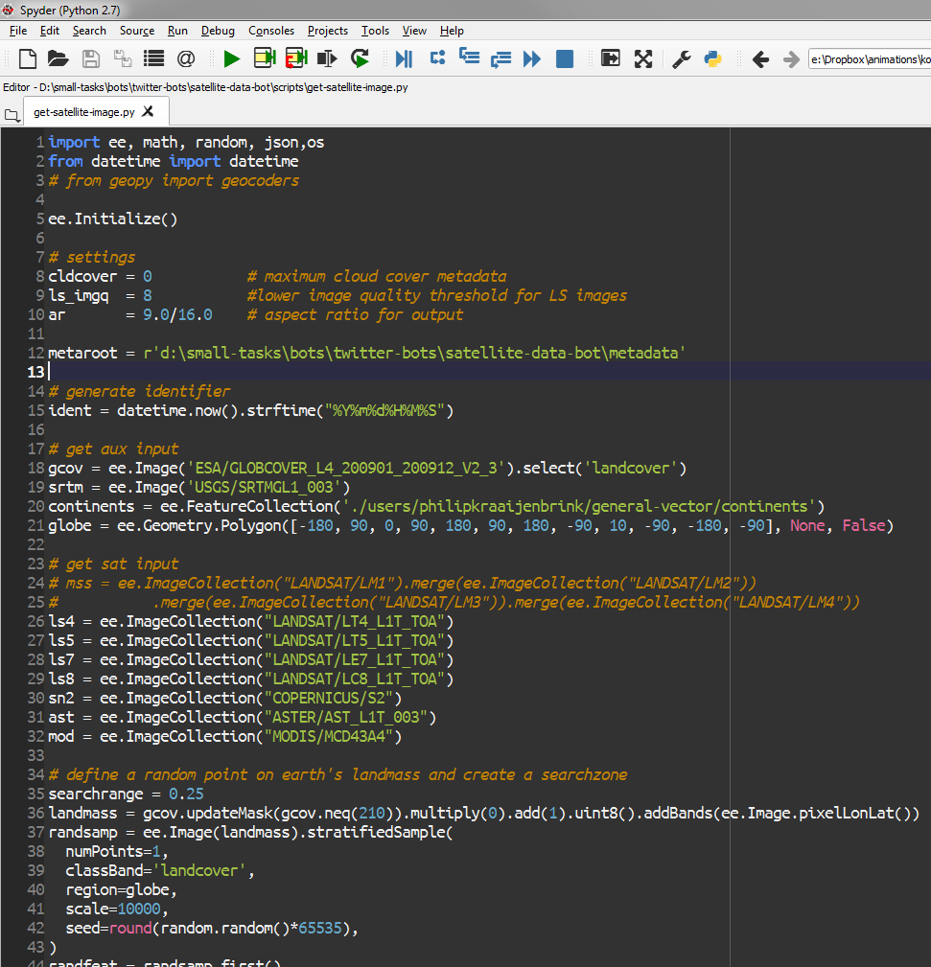
Access via
Web client with Javascript API
Python API

Slide 24
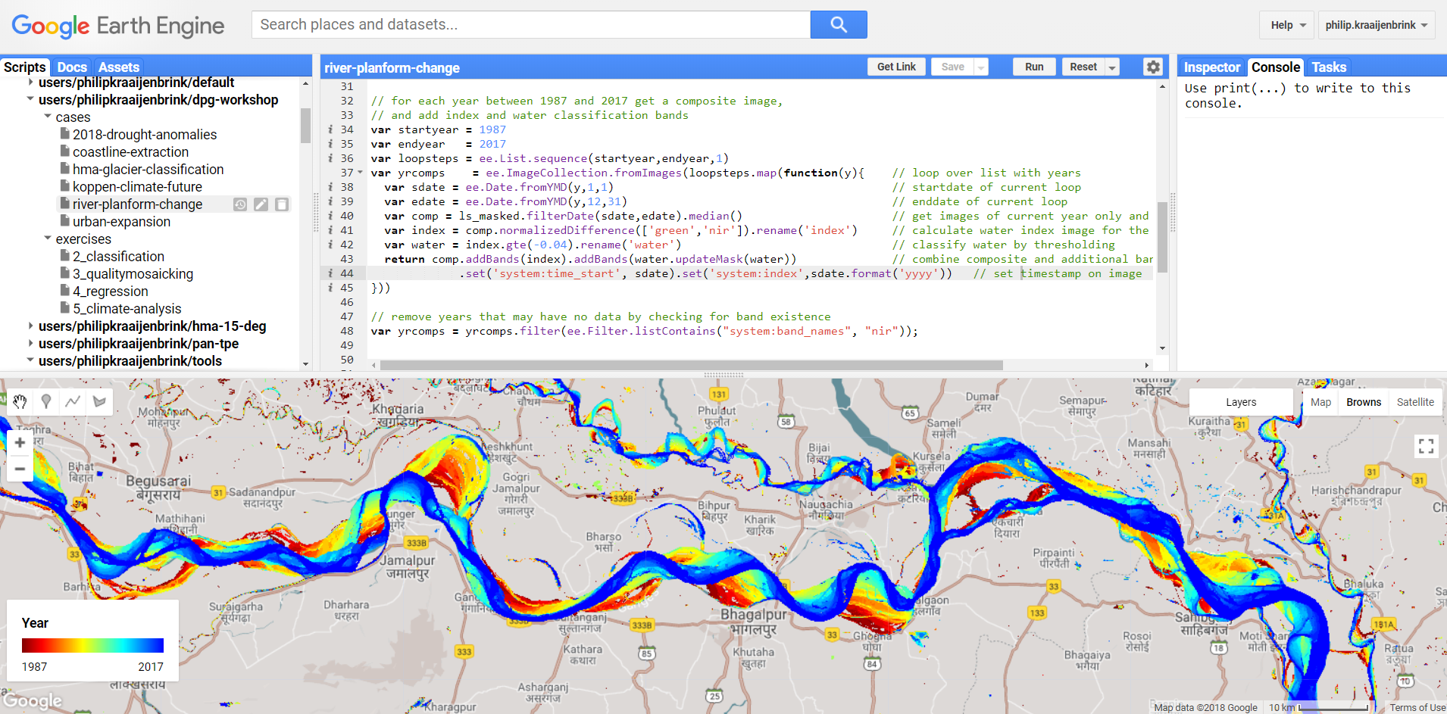
Online code editor

